Slide 1
Exception Handling
By Dr Shantanu Pathak

Slide 2
Errors and Exceptions
Errors : at compile time
Syntax Error : also known as parsing errors
Here compiler displays ^ ( arrow) , token before arrow is causing error
Also, file name and line number are given
Exceptions: errors detected at runtime
These are exceptional situations occurring at run time
Stack trace is given before the last line
LAST line indicates the problem and type of the exception

Slide 3
Propagation of Exception
Following is how un-handled exception propagates
Current function (Exception)
Calling Function
Main program

Slide 4
What is need to Handle Exceptions?
If not handled -> they stop the program
Advantage of Handling Exception
Can give meaningful message to the user
Can handle exception if possible and continue the program without stopping it
Ex. File doesn’t exists -> Solution: create new file

Slide 5
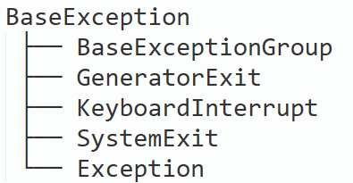
Which Exceptions are fatal ( can’t be handled )?
BaseException class is base of all Exceptions in Python
Hierarchy is shown below
Exception is child-class of BaseException. And, Exception is base class of all non-fatal exceptions
Non- fatal exceptions can be handled by us
Other child-classes of BaseException are FATAL. Ex. GeneratorExit, KeyboardInterrupt, SystemExit

Slide 6
How to handle Exceptions
Try – except block
Used to handle various exceptions
Parts of try-except block
try ( ONLY one)
except ( ONLY one executed out of multiple given)
else ( Optional )
finally ( Optional and always executed )
Graphical representation
How try selects next block or relevant except block

Slide 7
try block
It is used to write code which MAY cause exception
It can be simple code or call to a functions
Exceptions occurred in functions which are CALLED in try block are also handled here
If exception occurs,
remaining try block is skipped
try block passes exception to one of except blocks which is relevant for that type of exception and Then execution continues after try-except block
If NO relevant except block then exception passed to outer try or calling function, if still no handler found then send exception to main program and execution stops
If no exception then control goes to else (if ‘else’ block is present)

Slide 8
except block
One try can have multiple except blocks attached, BUT ONLY one relevant block is executed
Syntax: except <Exception Name>
Example :
except ZeroDivisionError:
print(“Divide by Zero”)
One except block can address multiple types of exceptions using tuple
ex. execpt ( TypeError , NameError ) :
pass

Slide 9
except block
How relevant block is selected ?
When exception ‘e’ comes in try block
Try block starts match top to bottom, the exception with exception name written in front of every except block
If exact match :: execute the exception block
If base class of exception present in except block : execute the exception block
If derived class of ‘e’ present in except block : NOT MATCHED
If NO MATCH : exception passed to outer try / calling function / main script

Slide 10
Example of Hierarchy of exception classes
Which type of exception type can handle another type ?
Exception
ArithmeticError
ZeroDivisionError
FloatingPointError
LookupError
KeyError

Slide 11
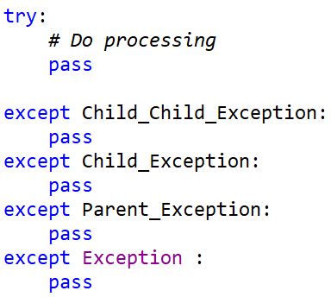
How to arrange Except Blocks

Slide 12
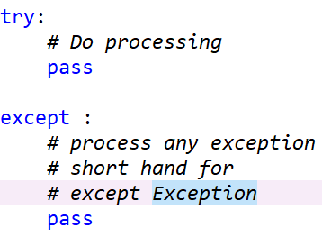
When happens if write ONLY except ?

Slide 13
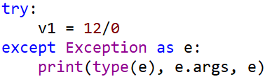
Passing Arguments to Exception
While raising an exception arguments may be passed
Different Built-in Exceptions use different arguments and types of arguments
To capture the exception’s arguments variable needs to be mentioned after exception name
This variable can be used, to access the arguments for that exception

Slide 14
Else block
If try clause executes correctly then control goes to Else block (if present)
Else is optional block
It is used to write extra statements for which you don’t want to catch exceptions in original try block

Slide 15
Finally Block
It is optional block
It always executes even if there is exception or no exception in try block
It is always executed even if there is return statement in try or except block still finally is executed before returning from try and except block

Slide 16
raise keyword

Slide 17
raise
Raise is used to pass the occurred exception to outer try block or calling function.
Argument to raise keyword is ONLY one
Either instance of exception which needs to be passed
OR exception class for which exception needs to be raised
Using ONLY raise will re-raise the current exception
Only writing raise without any active exception, will give RuntimeError

Slide 18
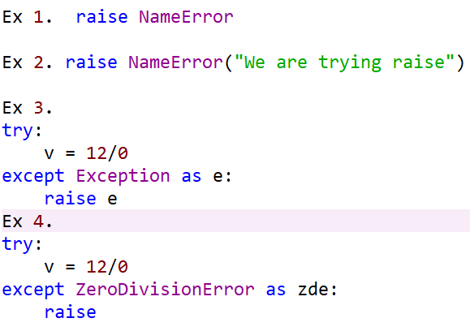
raise Examples

Slide 19
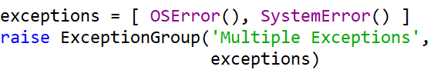
Extra
Exception Chaining
Occurs when there is exception while you are handling an exception in except block
Raise can use “from” keyword to indicate exception within exception handling
On the other hand, using “from None” argument to raise will disable exception chaining
ExceptionGroup
This class allows to raise list of multiple exceptions together

